Slide 1

Diabetes Screening tool
Presented By
Kellie Brabec
Rachel Conner
Tom Nisbet
Ash Seth
Andrew Stewart

Slide 2
introduction
WHY DID WE SELECT THIS TOPIC ?

Slide 3
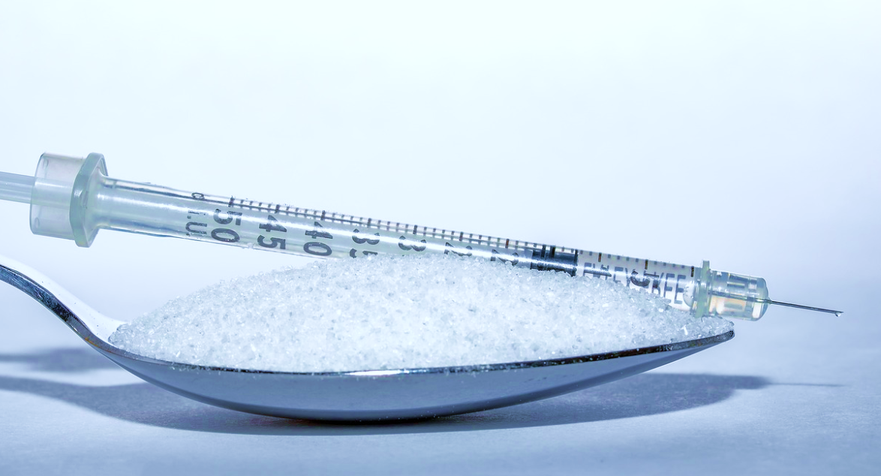
SOME FACTS
37.3 million people have diabetes
(11.3% of the US population)
Diagnosed: 28.7 million people, including 28.5 million adults
Undiagnosed: 8.5 million people (23.0% of adults are undiagnosed)
96 million people aged 18 years or older have prediabetes (38.0% of the adult US population)
65 years or older: 26.4 million people aged 65 years or older (48.8%) have prediabetes
Source: https://www.cdc.gov/diabetes/data/statistics-report/index.html

Slide 4
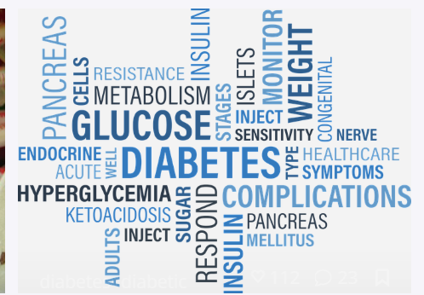
opportunity
Large sample data can be used to visualize underlying patterns and correlations
Sufficient data sample to develop and train machine learning model
Risk factors subset can be used to predict likelihood of diabetes

Slide 5
Data analysis and visualization
Decisions on binning, handling duplicate data and organizing columns

Slide 6
Data preprocessing
We looked at dataset with 253,680 survey responses
Target variable Diabetes_012 consisted of 3 classes. 0 is for no diabetes, 1 is for prediabetes, and 2 is for diabetes. There is class imbalance in this dataset. This dataset had 22 columns (feature variables)
Binning was performed to mainly get target variable into 2 buckets- those with diabetes plus prediabetes in one bin and those without diabetes in other bin
Binning was also performed on data informing BMI, mental health and physical health
Columns were organized and team created few subsets with and without duplicate data removal ( prior to and after binning)

Slide 7
visualizations
Data visualization was performed with matplotlib and imported libraries pandas, numpy and seaborn
Data was cleaned, chart type chosen and data was prepared to create necessary charts and plots
Correlation graph was created to get a big picture view of correlation between target variable- diabetes status against dependent variables
The final selected plots and graphs are displayed in the carousal

Slide 8
Machine learning model
Comparison and selection of machine learning model

Slide 9
Machine learning models considered
Logistic regression model: 84% accuracy
Random forest classifier: 84% accuracy
Support vector machine:

Slide 10
screening tool, front end display and backend logic
Screen displays static visualizations and screening questions

Slide 11
User interface and backend code
Screen build using Bootstrap accordion framework to expand and collapse various sections
Visualization created are displayed through expandable carousal
User is prompted to take health risk assessment and questions collect a yes/no response
No response -> -1, Yes -> 1 and No -> 0
Upon ‘submit’ button click on the screening form the response feeds into machine learning model and predicts if respondent needs to go for health check or not.
Support vector machine:

